Slide 1



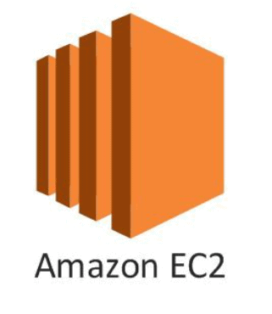




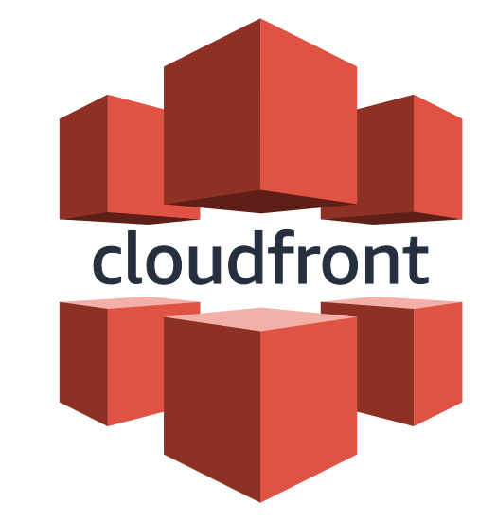

Hosting Strategies
Renato Matos & Damasio Sabino
2023/08

Slide 2


Speakers
Damásio is a software engineer which main framework is .NET - mostly backend oriented but open to frontend. Talk to him about Agile, Cloud, DevOps practices and thinking (knowledge exchange). Outside of work he spends time with his family, friends and doing Brazilian Jiu-jitsu and/or Muay Thai.
Renato is a full stack developer focusing on .NET backend. During his free time, Renato enjoys watching Netflix series', reading books, and spending quality time playing with his dogs and his lovely child.

Slide 3
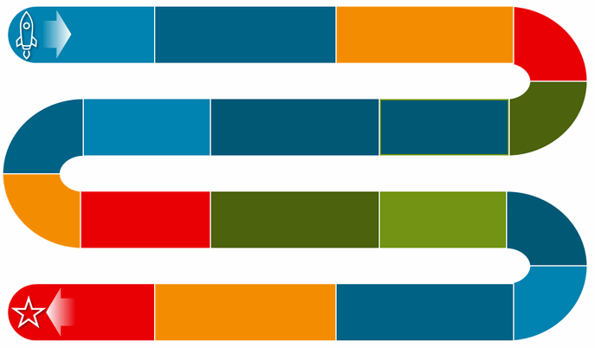




Agenda
Pricing
Calculator
Notes:
1 – Explain presentation structure
2 – Mention the resources
3 – Jump to github

Slide 4
Exploring our Repo

Slide 5
Route 53 - Hosted Zone

Slide 6
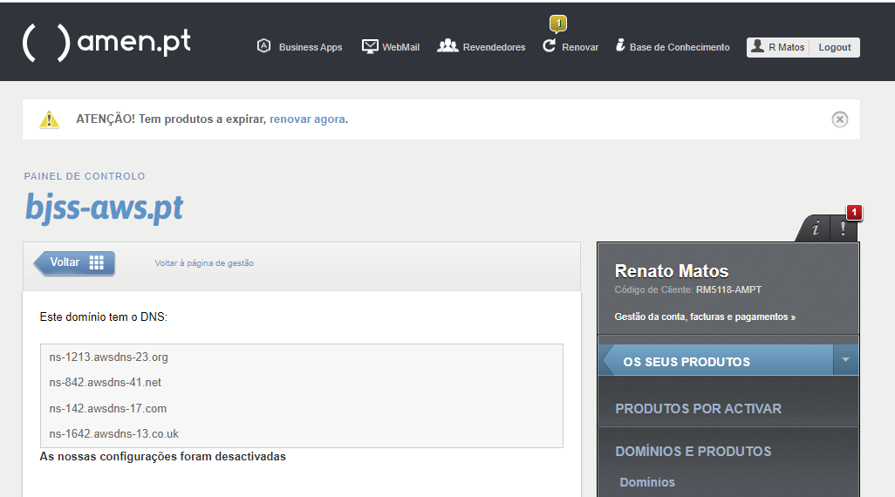

Slide 7
AWS Certificate Manager Provision and manage SSL/TLS certificates with AWS services and connected resources

Slide 9

Here we go!
Pricing
Calculator

Slide 10
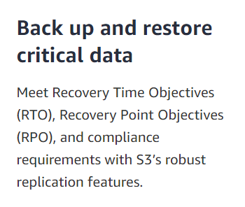

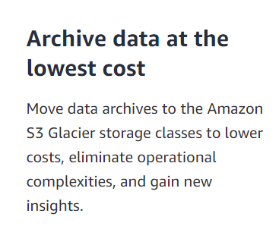
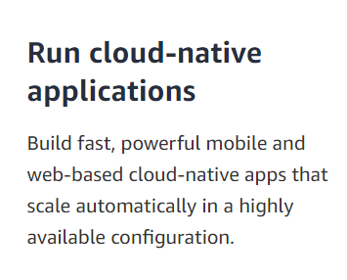

Slide 12
Amazon CloudFront Securely deliver content with low latency and high transfer speeds

Slide 13
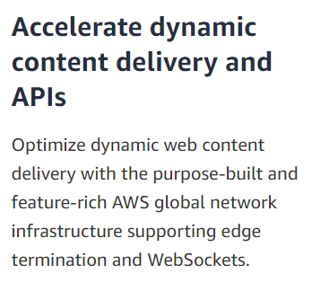
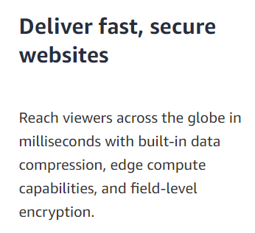
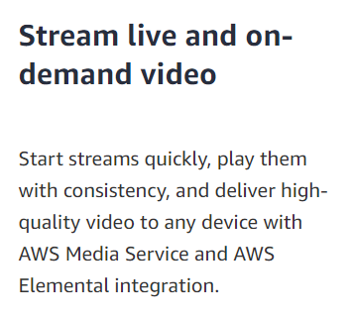
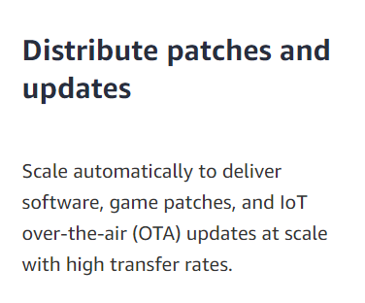

Slide 15
AWS Amplify Build full-stack web and mobile apps in hours. Easy to start, easy to scale

Slide 16
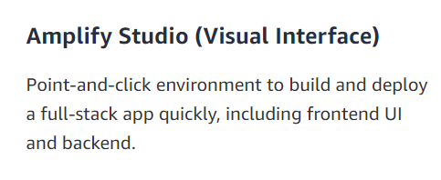
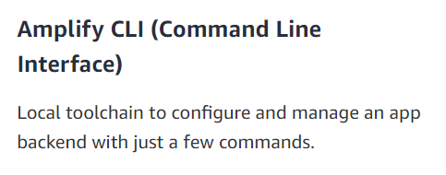
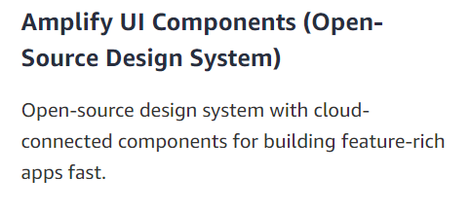
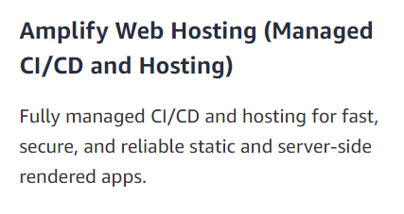

Slide 18
AWS Amplify Listening to the GitHub repository changes

Slide 20
Here we go!
Pricing
Calculator

Slide 21
Amazon EC2 Secure and resizable compute capacity to support virtually any workload

Slide 22
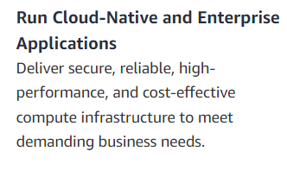
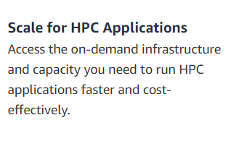
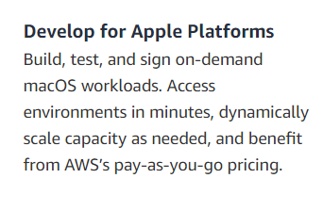
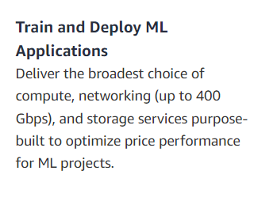

Slide 24
AWS Elastic Beanstalk Deploy and Scale Web Applications

Slide 25
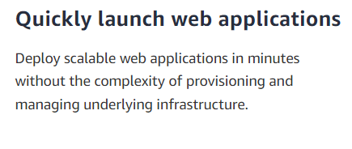
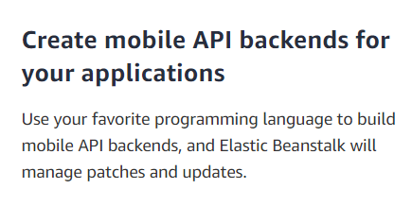
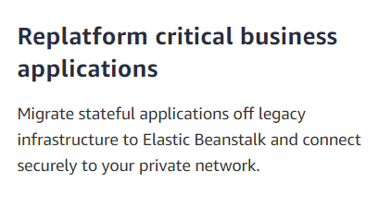

Slide 27
AWS Elastic Container Service Run highly secure, reliable, and scalable containers

Slide 28
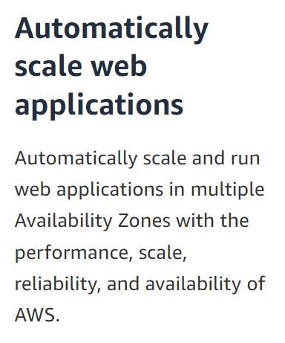
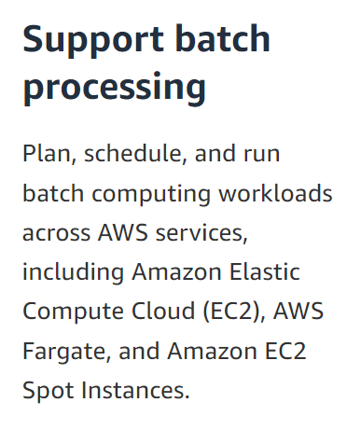
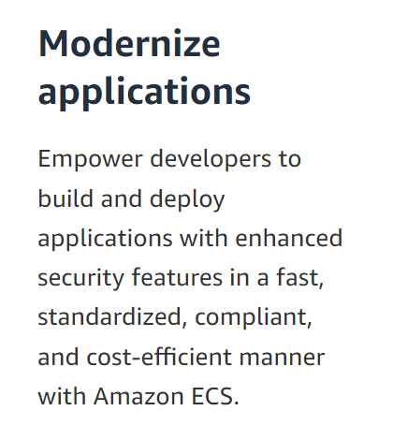
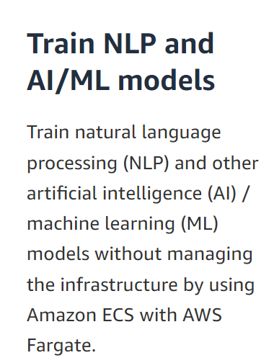

Slide 29




Setup our Elastic Container Registry
Easily store, share, and deploy your container software anywhere
Create a Service to run our Task
Launch a group of tasks handling a long-running
computing work that can be stopped and restarted.
For example, a web application.
Create our Cluster
Logical grouping of tasks or services
Define a Task Definition
The Docker image to use with each container in your task
How much CPU and memory to use with each task or each container within a task
The launch type to use, which determines the infrastructure that your tasks are hosted on
The Docker networking mode to use for the containers in your task
The logging configuration to use for your tasks
Whether the task continues to run if the container finishes or fails
The command that the container runs when it's started
Any data volumes that are used with the containers in the task
The IAM role that your tasks use

Slide 31
Here we go!
Pricing
Calculator

Slide 32
Amazon Elastic Kubernetes Service The most trusted way to start, run, and scale Kubernetes

Slide 33
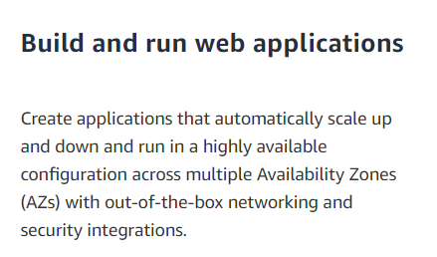
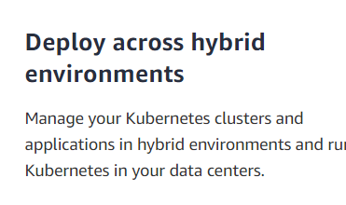
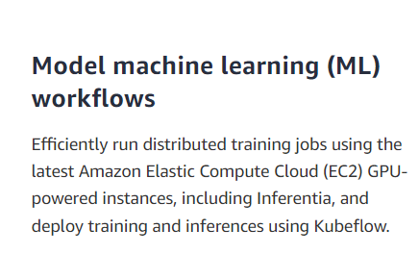

Slide 34
Manually Provision an EKS cluster (AWS)
Use Terraform to Provision an EKS cluster (AWS)
Specify a cluster name, Kubernetes version, and a cluster service role (with the enough grants to add AWS resources)
AWS Account, AWS CLI, Kubectl, and Install Terraform
Setup the network VPN and subnets
Apply the Terraform script
Define an Auto Scale Group and launch template (OS, Network, Instance Type, Storage)
Connect to the cluster and deploy our apps
Connect to the cluster and deploy our apps

Slide 35
# Install awscli
sudo yum remove awscli
curl "https://awscli.amazonaws.com/awscli-exe-linux-x86_64.zip" -o "awscliv2.zip"
unzip awscliv2.zip
sudo ./aws/install
# Installing kubectl
export K8S_RELEASE=1.27.0
curl -LO https://dl.k8s.io/release/v$K8S_RELEASE/bin/linux/amd64/kubectl
chmod +x ./kubectl
sudo install -o root -g root -m 0755 kubectl /usr/local/bin/kubectl
kubectl version --short
# Installing Terraform
# Install gnupg
sudo apt-get update && sudo apt-get install -y gnupg software-properties-common
# Install the HashiCorp
wget -O- https://apt.releases.hashicorp.com/gpg | \
gpg --dearmor | \
sudo tee /usr/share/keyrings/hashicorp-archive-keyring.gpg
# Add the official HashiCorp repository to your system
echo "deb [signed-by=/usr/share/keyrings/hashicorp-archive-keyring.gpg] \
https://apt.releases.hashicorp.com $(lsb_release -cs) main" | \
sudo tee /etc/apt/sources.list.d/hashicorp.list
# System update
sudo apt update
# Install Terraform
sudo apt-get install terraform

Slide 36
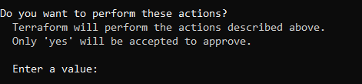
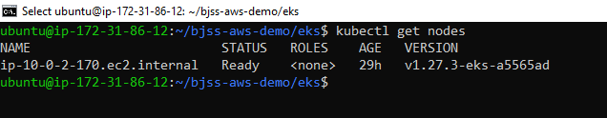

# Setup AWS Account
aws configure
AWS Access Key ID [****************2DW5]: type your access key
AWS Secret Access Key [****************rRF4]: type your secret
Default region name [us-east-1]:
Default output format [None]:
# Clone our GitHub repository
Git clone git@github.com:renatomatos79/bjss-aws-demo.git
cd bjss-aws-demo.git\eks
# Provisioning the cluster
terraform init
terraform apply

Slide 38
Here we go!
Pricing
Calculator

Slide 39

AWS Pricing Calculator Estimate the cost for your architecture solution. Configure a cost estimate that fits your unique business or personal needs with AWS products and services.

Slide 40
Go to https://calculator.aws/#/addService and add your services
Configure your services
View your total estimate
Cost considerations! Bear in mind these tips to save money!

Slide 42

What’s the configuration that enables S3 to handles application on its storage?
Which service is provisioned automatically by Cloudfront?
???
???

Slide 43
Check your answers
On S3 we have to enable Static Web App on its configurations
By configuring Cloudfront service, a S3 service is provisioned automatically
???
???
Notes:
Answer these questions for each of your server-side applications:
Things to consider when selecting how to deploy:
App architecture
Deployment method (manual vs automated)
Service dependencies/integration
Configurations
Availability
Required infrastructure (operating system etc…)
Release / Deployment process
Other things to consider:
What databases (type and version) do you need?
Are there any static files to serve?
What domain names and subdomains will you use, and where will they go?

Slide 44
Thank you! renato.matos@bjss.com damasio.sabino@bjss.com

